Slide 1
Sex Addiction: Is Recovery Necessary or Possible? MSCAP 2022 Eva & Roane Hunter
Powerpoint available at
SexGodChaos.com

Slide 3
Sexual Brokenness/Addiction Experts
Roane & Eva Hunter
Licensed Professional Counselors (LPC)
National Board-Certified Counselors (NCC)
Certified Sex Addiction Therapists – SUPERVISORS (CSAT-S)
International Institute Of Trauma & Addiction Professionals (IITAP)
Certified Clinical Sex Addiction Specialists
Christian Sex Addiction Specialists International (C-SASi)
Clinical Associates - American Board of Christian Sex Therapists (ABCST)
Certified Multiple Addictions Therapists - Supervisors (CMAT-S)
International Institute Of Trauma & Addiction Professionals (IITAP)
American Association of Christian Counselors
World Conference Speakers & Presenters – 2021, 2019, 2017
LifeWorksMS.com

Slide 4
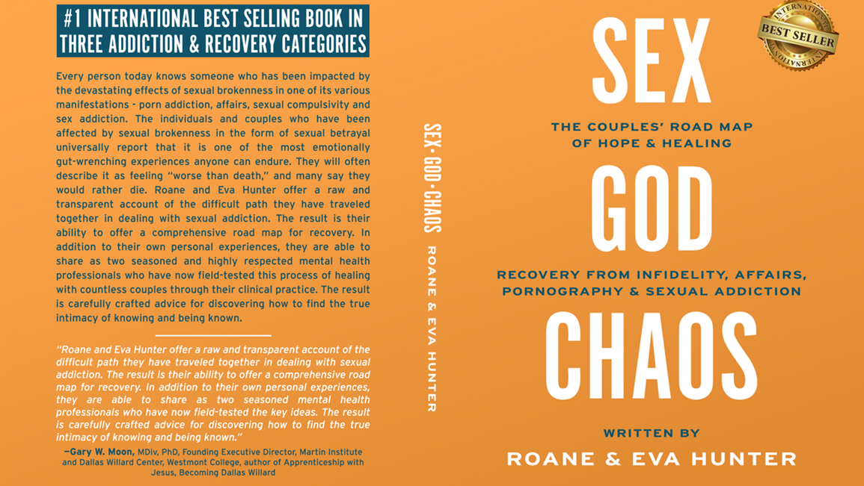

Slide 5
Sexual Addiction: Prevalance, Causes, & Treatment

Slide 6
Prevalence
Sex addicts come from all walks of life: male and female, all sexual orientations, ages from pre-teens to senior citizens, those employed as laborers, politicians, or CEOs of major organizations.
Sex addiction does not discriminate.
Many addicts were abused as children – sexually, physically, and/or emotionally.
Many grew up in families in which addiction already flourished, including alcoholism, drugs, gambling, and/or compulsive eating.
Most grapple with other addictions in addition to sex addiction, but often find overcoming sexual addiction the most difficult.

Slide 7
Prevalence
Sexual addiction, which is also known as hypersexual disorder, has largely been ignored by psychiatrists, even though the condition causes serious psychosocial problems for many people.
A lack of empirical evidence on sexual addiction is the result of the disorder’s complete absence from versions of the DSM-V
Existing prevalence rates of sexual addiction-related disorders range from 3% to 6%.
Sexual addiction/hypersexual disorder - an umbrella construct to encompass various problematic behaviors, including excessive masturbation, cybersex, pornography use, sexual behavior with consenting adults, sexting, strip club visitation, prostitution and other behaviors.
Sexual Addiction or Hypersexual Disorder: Different Terms for the Same Problem? A Review of the Literature, Current Pharmaceutical Design, 2014, Vol. 20, No. 00

Slide 8
Prevalence
Hypersexual disorder is a proposed diagnosis for people who engage in sex or think about sex through fantasies and urges to the point of distress or impairment. These individuals may engage in activities such as porn, masturbation, sex for pay, and multiple partners, among others. They may feel distress in areas of life including work, school, and relationships.
The concept of "sex addiction" is under heated debate. However, in a controversial decision, compulsive sexual behavior disorder was added to the World Health Organization's International Classification of Diseases. Some researchers see this tendency as a problem of regulating behavior, while other experts wonder whether this behavior derives from a higher sex drive or if it stems from impulse control problems.

Slide 9
Prevalence
Could This Be a Bigger Public Health Crisis?
Current Statistics – Internet Porn, Sexting, hook-up apps,…..
Over 40 million Americans are regular visitors to porn sites. The average visit lasts 6 minutes and 29 seconds
There are around 42 million porn websites, which totals around 370 million pages of porn.
47% of families in the United States reported that pornography is a problem in their home
Pornography use increases the marital infidelity rate by more than 300%.
56% of American divorces involve one party having an “obsessive interest” in pornographic websites
55% of married men and 25% of married women say they watch porn at least once a month

Slide 10
SEX in the Digital Age
According to Influence Central’s 2016 Digital Trends Study, the average age at which kids get their first smartphone is now 10.3 years old.
This is the average age, meaning that there are kids 8 years and younger with their own smartphones.

Slide 11
SEXTING – “Home-Produced Pornography”
A study published in JAMA Pediatrics in 2017 revealed that sexting (which is the electronic sharing of sexually explicit images, videos, or messages) has rapidly increased among teenagers since 2009.
The study found that about 1 in 7 (or 14.8%) of those between the ages of 12 and 17 had sent sexts and approximately 1 in 4 (27.4%) have received them. These numbers are significantly higher than those from a 2009 Pew Research Center study that revealed that 4% and 15% of 12 to 17 year olds had sent and received sexts, respectively.

Slide 12
SEX in the Digital Age
Before we say, "kids these days," keep in mind that these sexting numbers for kids are still well below those for adults.
A MacAfee survey (2017) showed that about 50% of adults had "used their mobile device to share or receive sexual content."
The same survey found that 16% had sent sexual images to complete strangers.
A study presented in 2015 at the American Psychological Association’s 123rd Annual Convention yielded even higher numbers: 88% of study participants reported ever having sexted and 82% reported they had sexted in the past year.

Slide 13
The Internet Porn Tsunami
Dr. Jill Manning, a licensed marriage and family therapist, testified before the U.S. Senate that 56 percent of divorce cases involve one party having an obsessive interest in pornographic websites.
Dr. Kevin B. Skinner wrote in a Psychology Today article that "Every year for the past decade there have been roughly 1 million divorces in the United States. If half of the people divorcing claim pornography as the culprit, that means there are 500,000 marriages annually that are failing due to pornography.“
Representatives from the AAML have stated that less than a decade ago, pornography didn't appear in divorce cases.
Data from American Academy of Matrimonial Lawyers

Slide 14
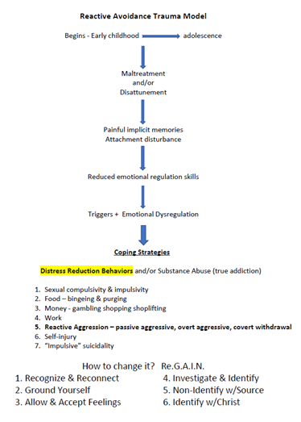
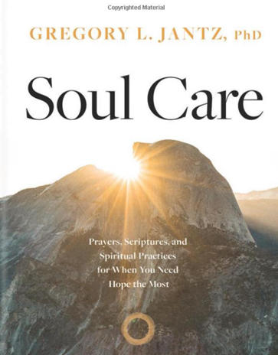
Other Approaches?

Slide 15
Other Approaches
A Spiritual Dis-ease
(aka “False Intimacy”, or an “Intimacy Disorder”)
“Every knock on the door of a brothel is a knock on the door of heaven” – G.K. Chesterton
The cure is connection – True Intimacy!
Connection with God,
Connection with our True-Self in Christ,
Connection with one another!

Slide 16
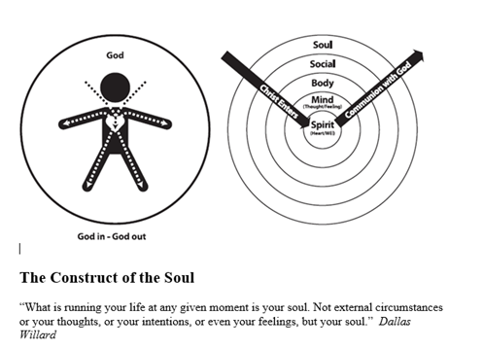
Psychology – Roots & Origin – Back to the Beginning

Slide 17
Sexual Brokenness
Systemic Cultural Issue
Porn Addiction (Compulsivity)
Classic Sexual Addiction (Compulsivity)
Sexual Impulsivity
Emotional/Physical Affairs
Sexual Abuse
Sexual Aversion (Anorexia)
Eroticized Rage
Pornification of Culture (Music, Movies, TV)
Make-up Sex
Punitive Withholding
Prostitution
Exhibitionism/Voyeurism
Frotteurism
Obligatory/Duty Sex (The Great Sex Rescue)
Female Pornography (Romance Fantasy)
Home Produced Pornography (Sexting)
Sex & Love Addiction (Infatuation)
Sexual Bargaining (Using Sex)
Body Image Issues
Sexual Shame (Past Behaviors)
Sex Negative Messages/Spiritual Abuse
Sexual Confusion/Gender Dysphoria
Unwanted Same Sex Attraction
Loose Boundaries (Sexual Jokes, Innuendo)
This is only a partial list……

Slide 18
Prevalence
In the case of out-of-control sexual behaviors, researchers have largely fallen into one of four camps:
The out-of-control sexual behaviors are indicative of an addictive disorder (like substance abuse addictions),
The behaviors are indicative of a hypersexual disorder (excessive sexual behaviors/output in a given time period),
The behaviors are indicative of an impulse-control disorder (impulsivity-driven sexual behaviors), or
The behaviors are indicative of a compulsive disorder (compulsive sexual behaviors, perhaps a symptom of an obsessive-compulsive disorder or OCD).

Slide 19
Diagnosis
Recurrent failure (pattern) to resist sexual impulses to engage in specific sexual behaviors
Engaged in sexual behaviors to a greater extent or over a longer period than intended
Long-standing desire, or a history of unsuccessful efforts to stop, reduce, or control sexual behaviors.
Spent excessive time obtaining sex, being sexual, or recovering from sexual experiences
Obsessed with preparing for sexual activities

Slide 20
Diagnosis
Frequently engaged in sexual behavior when expected to be fulfilling occupational, academic, domestic, or social obligations
Continued sexual behavior despite knowing it has caused or exacerbated social, financial, psychological, or physical problems
Increased the intensity, frequency, number, or risk of sexual behaviors to achieve the desired effect, or experience diminished effect when continuing behaviors at the same level of intensity, frequency, number or risk.

Slide 21
Diagnosis
Given up or limited social, occupational, or recreational activities because of sexual behavior
Become upset, anxious, restless, or irritable if unable to engage in sexual behavior.

Slide 22
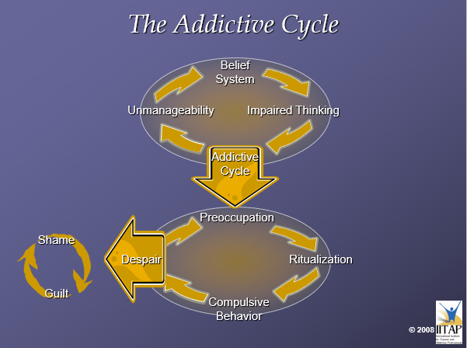

Slide 24
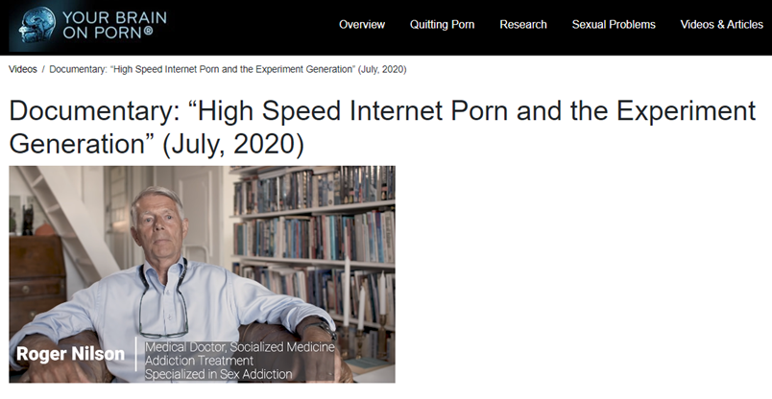
"High Speed Internet Porn &
the Experiment Generation"
By Dani Lind and Felix Thurfjell
The Great Porn Experiment Gary Wilson TEDxGlasgow

Slide 25
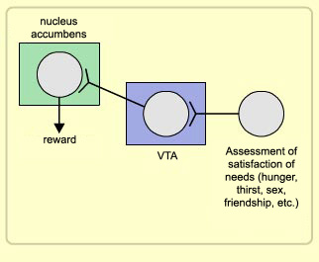
Researchers have found that the main centers of the brain’s reward circuit are located along the medial forebrain bundle (MFB). The ventral tegmental area (VTA) and the nucleus accumbens are the two major centers in the reward circuit, but it also includes several others, including the amygdala which contain the instinctive responses of fear, action, or aggression (fight, flight, or freeze).
The chemical messenger that makes the connections between these two groups of neurons is dopamine. This is the site where most drugs act and cause dependencies. Watching porn/having sex releases endogenous opiates that flood brain/body; endorphins, oxytocin, testosterone, dopamine, adrenaline, serotonin, etc, and these are processed as poly-drug self medication.

Slide 26
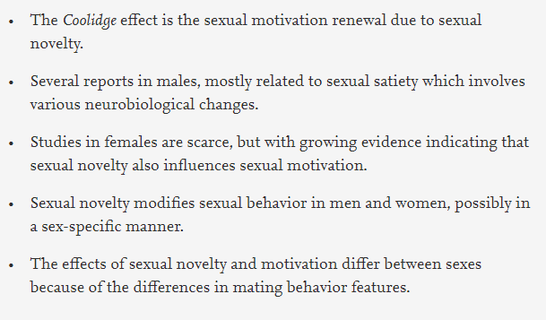
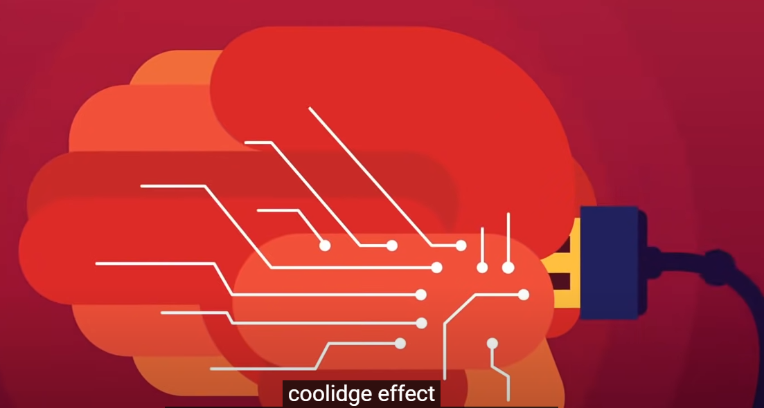
The Coolidge Effect
The unlimited variety & novelty of high-speed internet porn is why it can become highly addictive – crack cocaine effect.

Slide 27
The Internet –
“Have It Your Way”
• Sexual Norms are changing
• The internet, social media, smartphones, and virtual sex at the click of a finger.
• Fast fixes like sexual menus

Slide 28
Internet Pornography Changing the Way People Treat People
“Deanthropornography” (dehumanization of the most sacred part of being human – our sexuality)
• Changing our sexual appetite
• It’s increasingly violent
• Influencing what it means to be human.

Slide 29
The Internet Porn Tsunami
Dr. Jill Manning, a licensed marriage and family therapist, testified before the U.S. Senate that 56 percent of divorce cases involve one party having an obsessive interest in pornographic websites.
Dr. Kevin B. Skinner wrote in a Psychology Today article that "Every year for the past decade there have been roughly 1 million divorces in the United States. If half of the people divorcing claim pornography as the culprit, that means there are 500,000 marriages annually that are failing due to pornography.“
Representatives from the AAML have stated that less than a decade ago, pornography didn't appear in divorce cases.
Data from American Academy of Matrimonial Lawyers

Slide 30
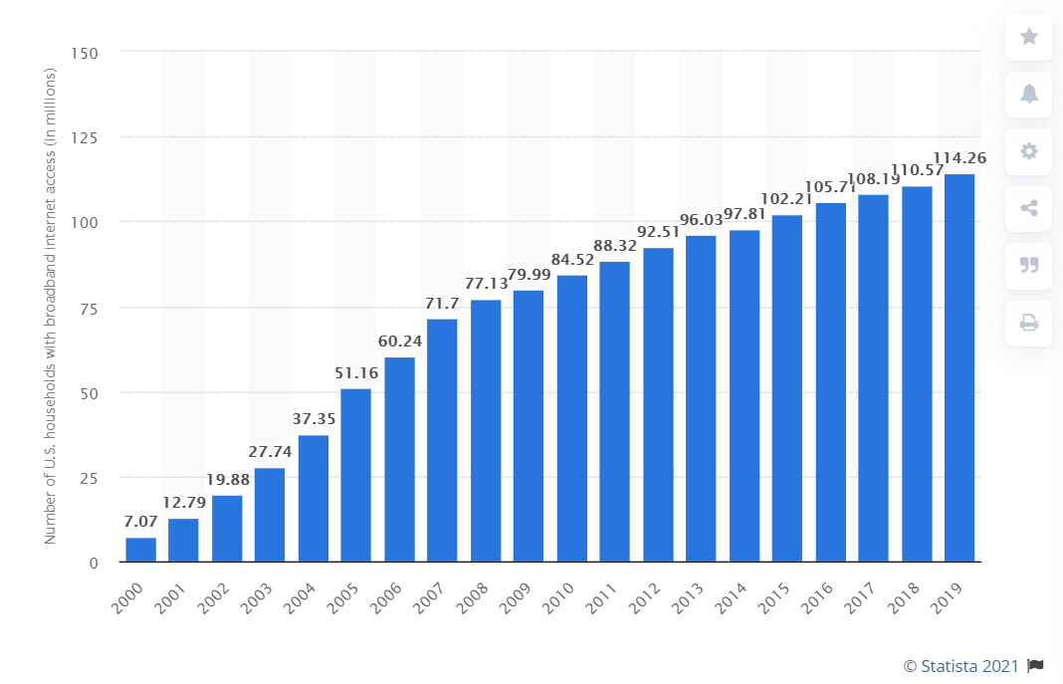
The Internet Porn Effect
Number of fixed broadband subscriptions in the United States from 2000 to 2019(in millions)

Slide 31
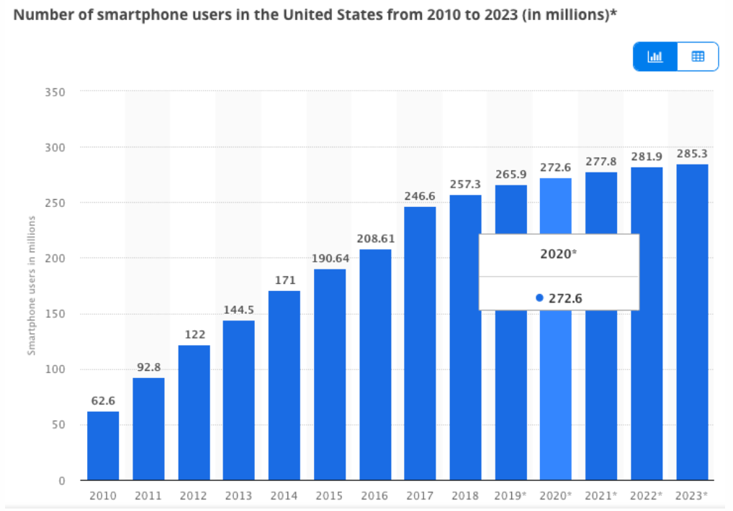

Slide 32
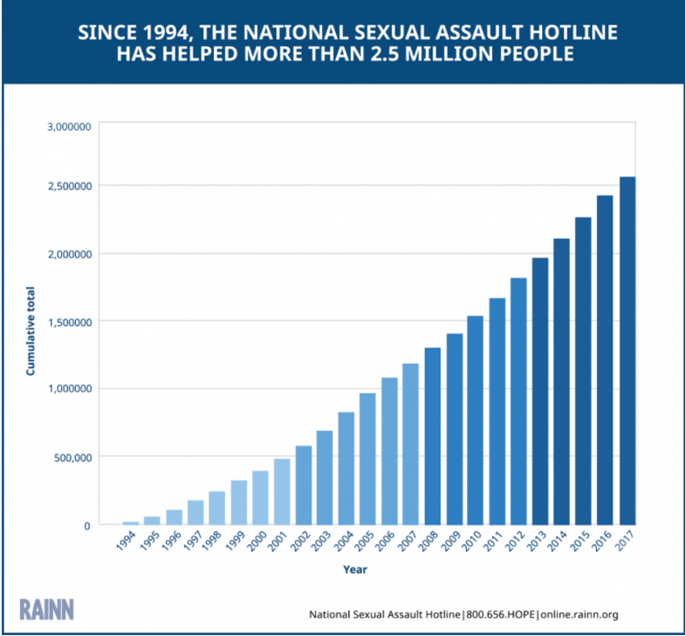

Slide 33
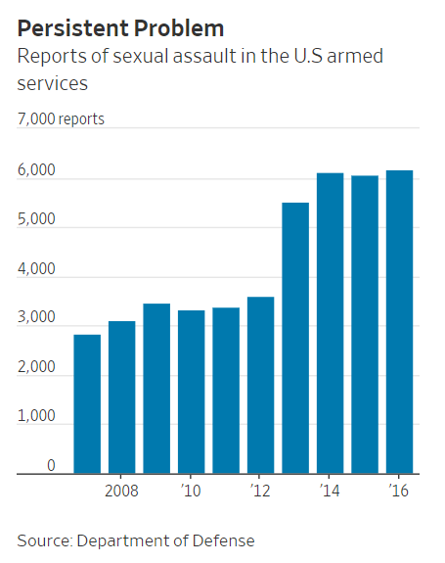

Slide 34
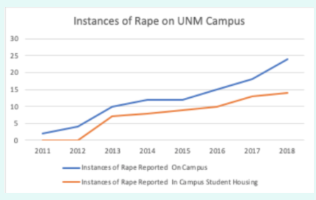
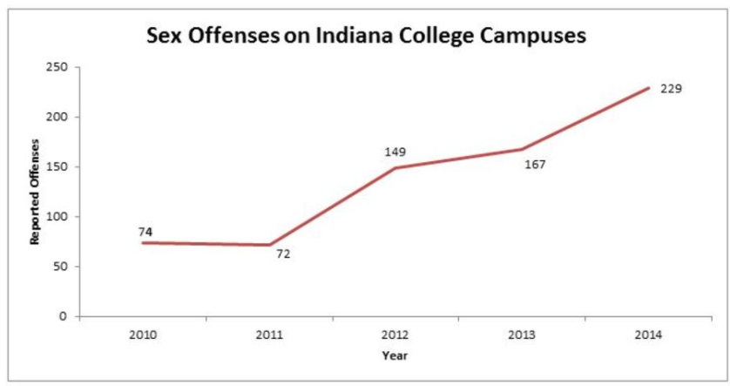
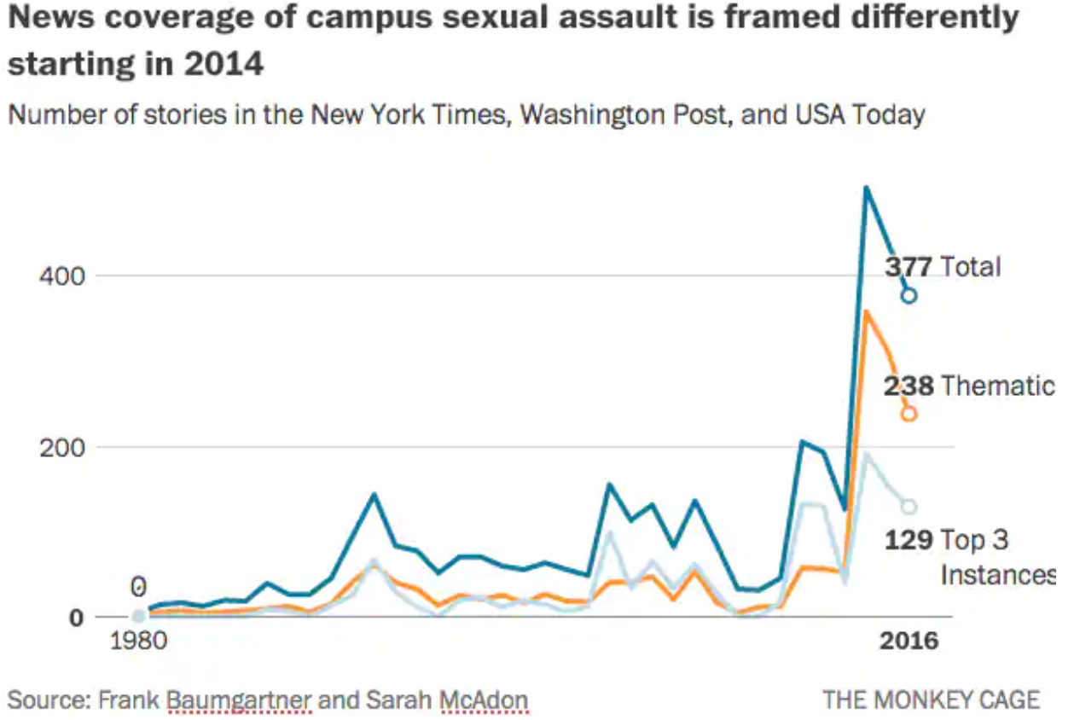
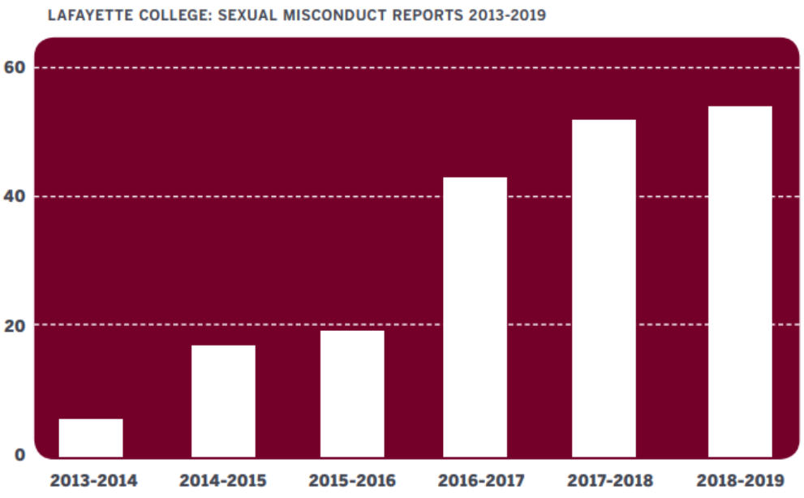

Slide 35
Triple-A Engine of Internet Porn

Slide 36
Assessment
Sexual Addiction Screening Test & the Sex Addiction Risk Assessment – both available at: https://sexhelp.com/online-tools-for-sex-help/
Designed to assist in the assessment of sexually compulsive behavior which may indicate the presence of sex addiction.
Developed in cooperation with hospitals, treatment programs, private therapists, and community groups, the SAST provides a profile of responses which help to discriminate between addictive and non-addictive behavior.
Comprised of 45 yes or no questions.

Slide 37
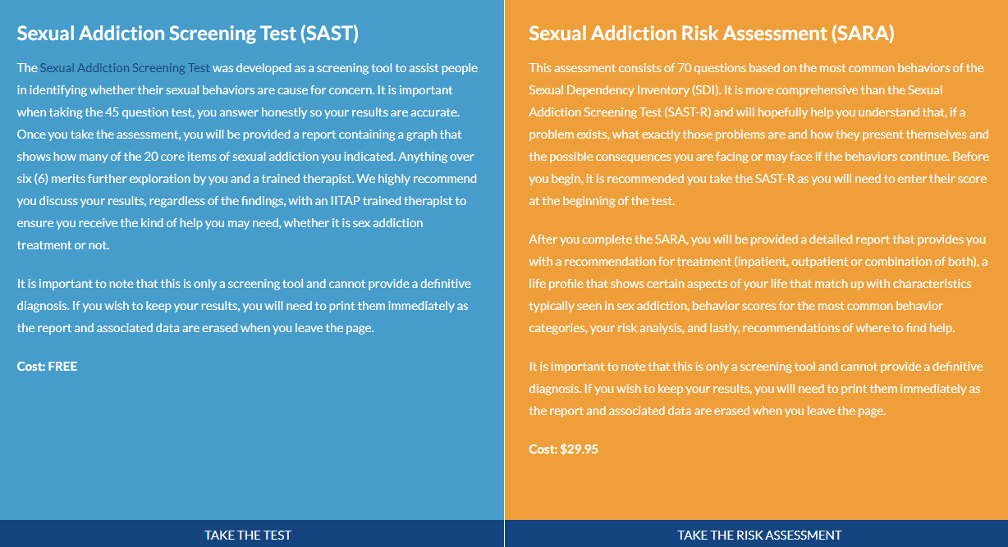
Assessment

Slide 38
Assessment
SDI–R Online
SDMI Online
* Only available to CSAT therapists

Slide 39
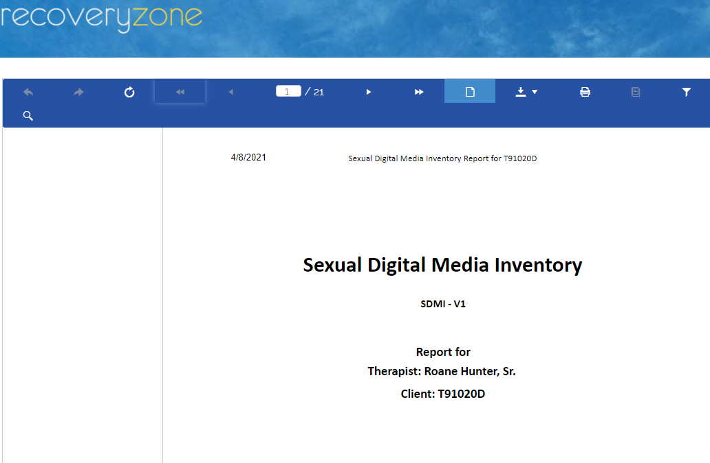

Slide 40
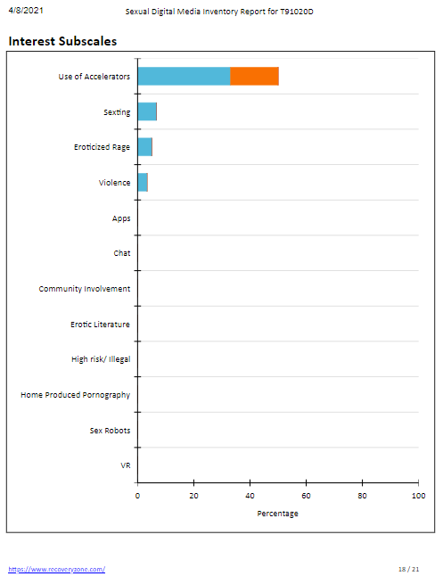
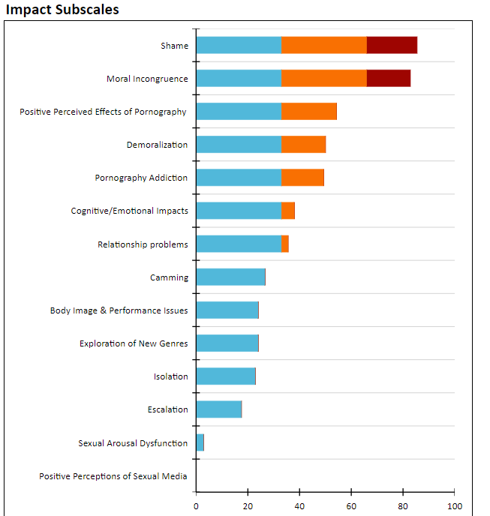

Slide 41
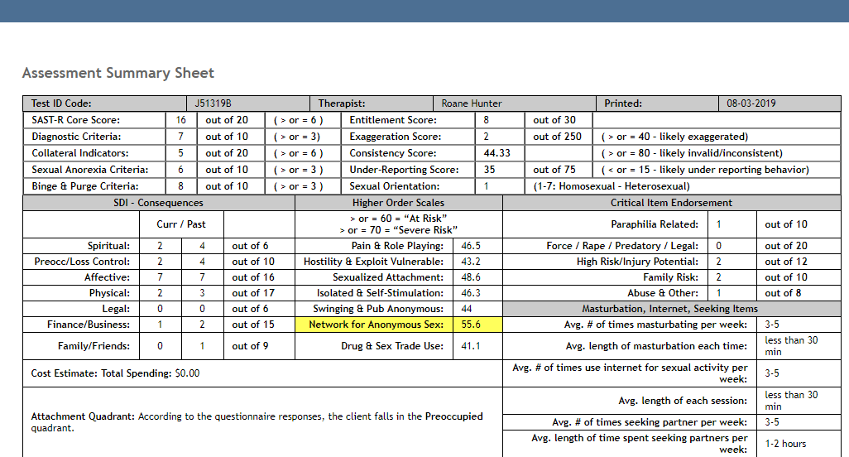
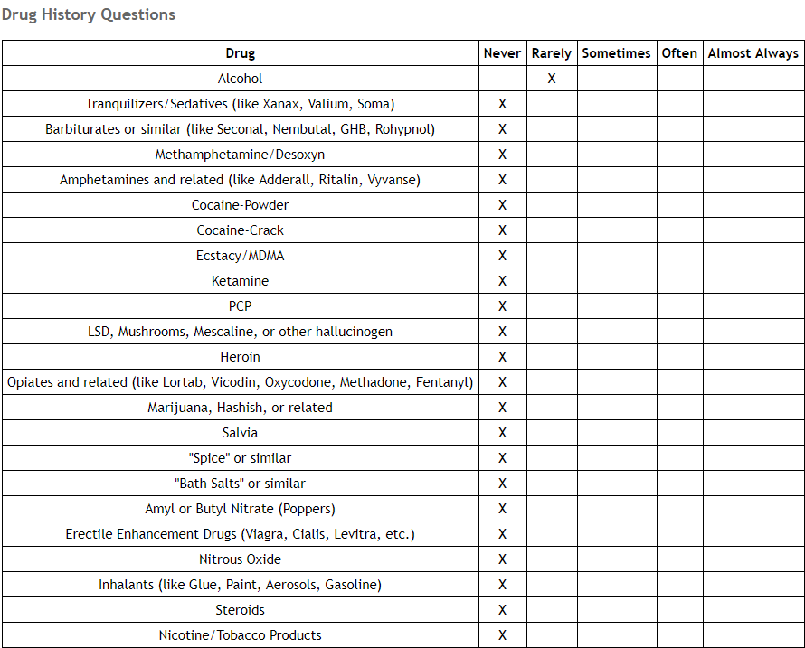
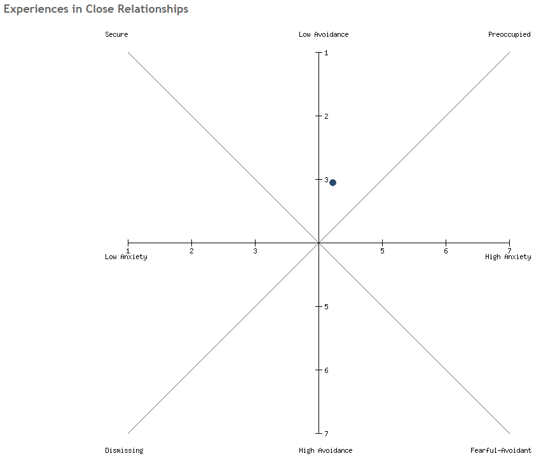
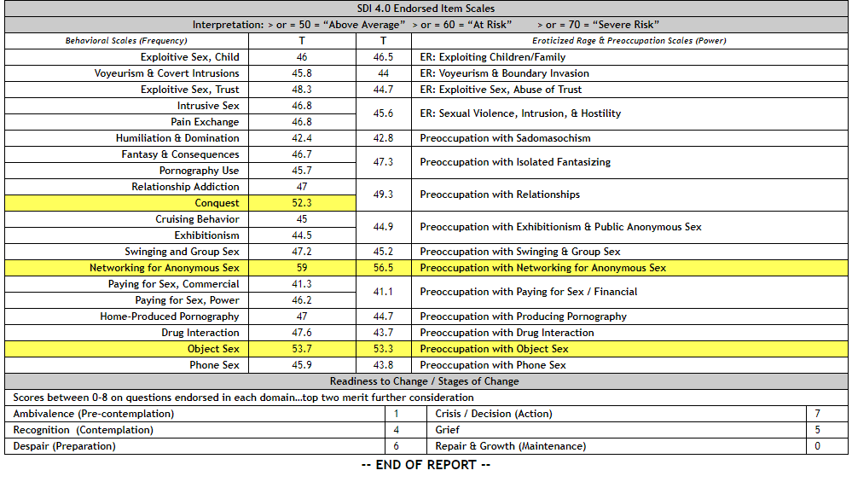
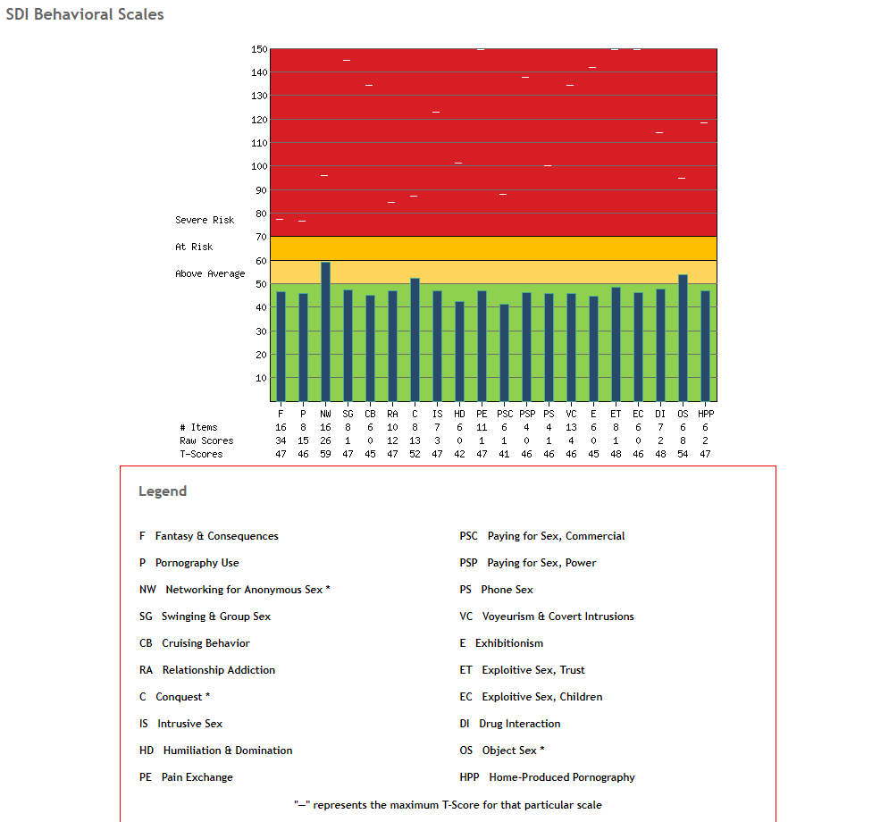
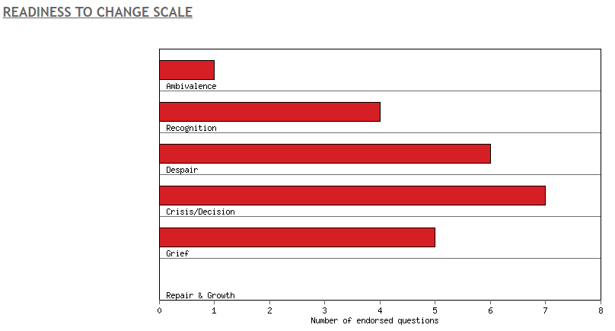

Slide 42
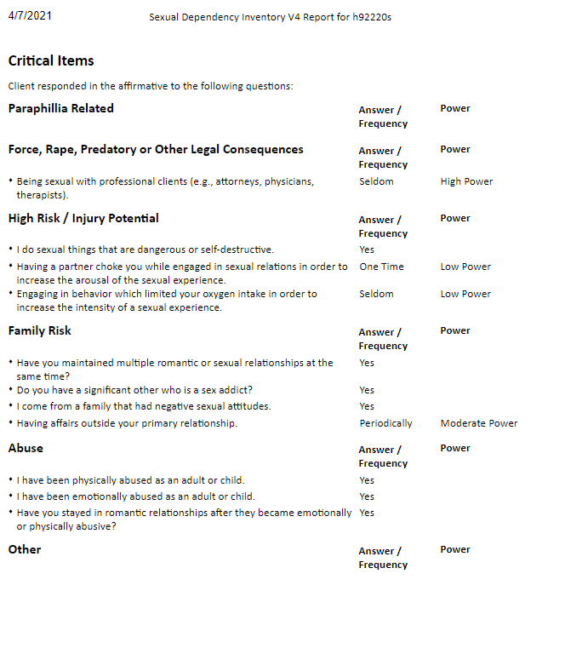
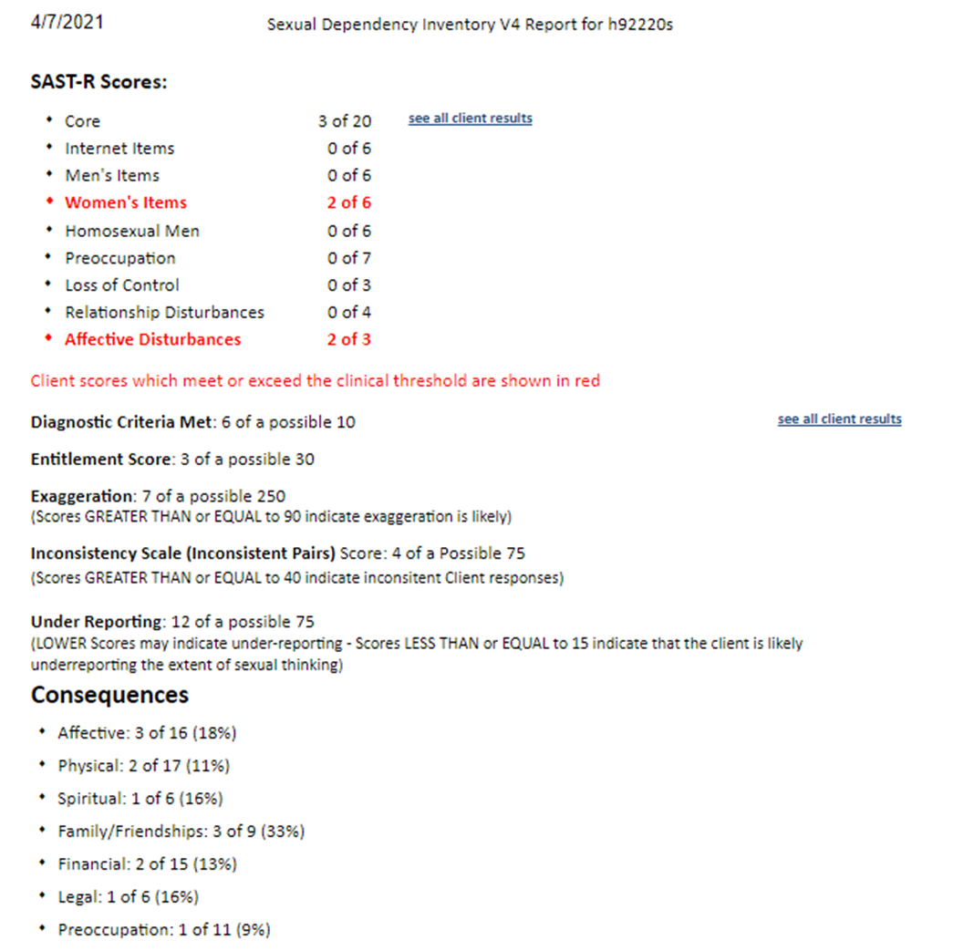

Slide 43
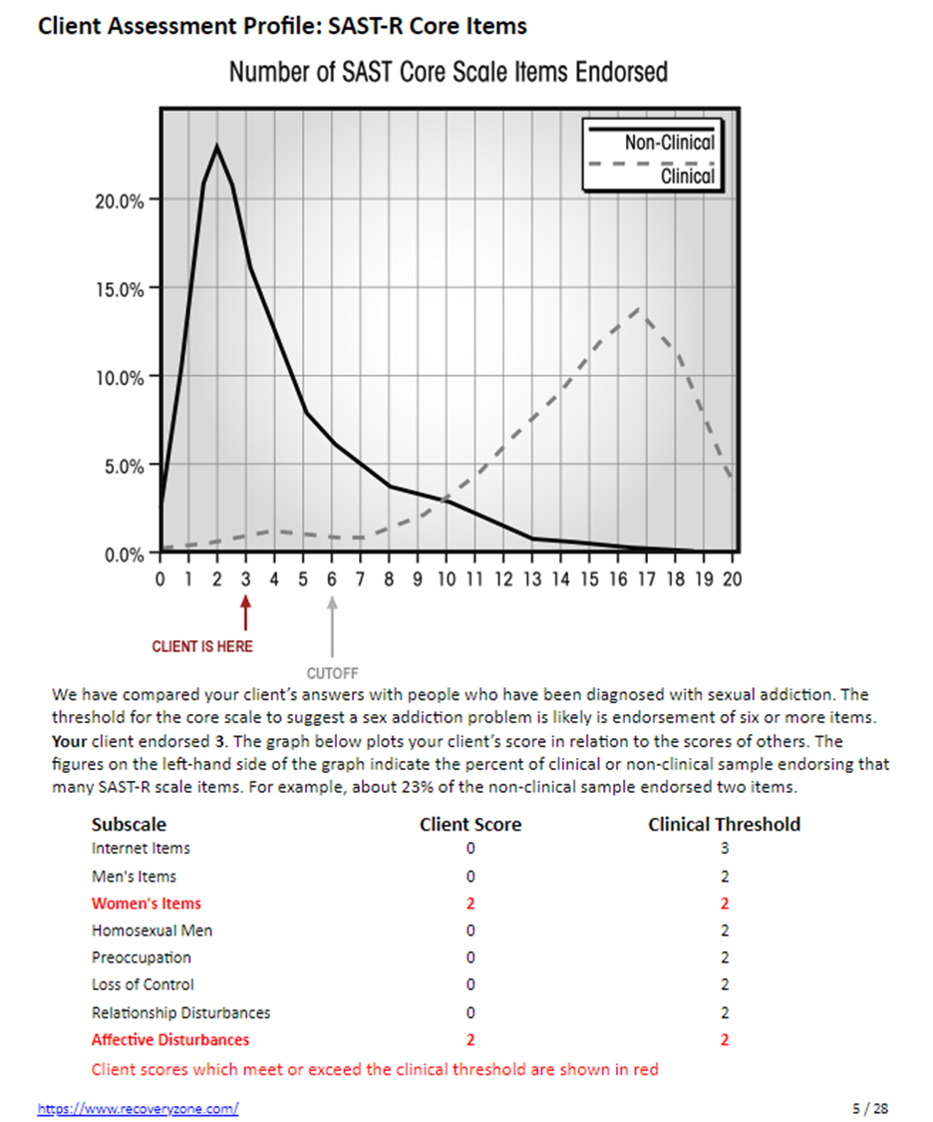
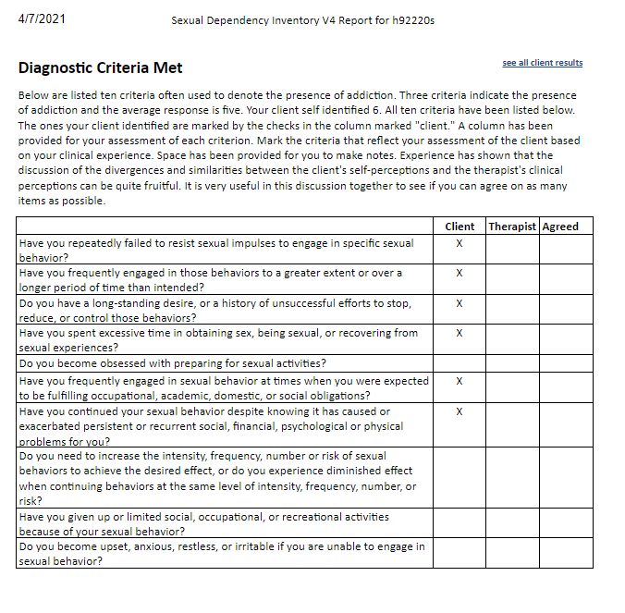

Slide 44
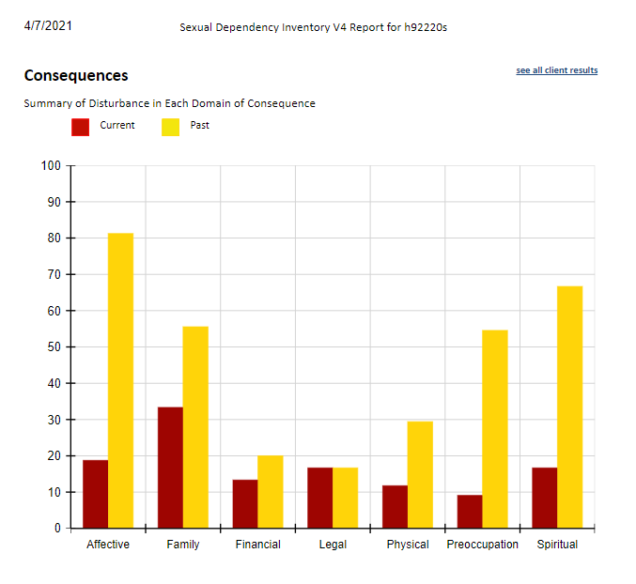
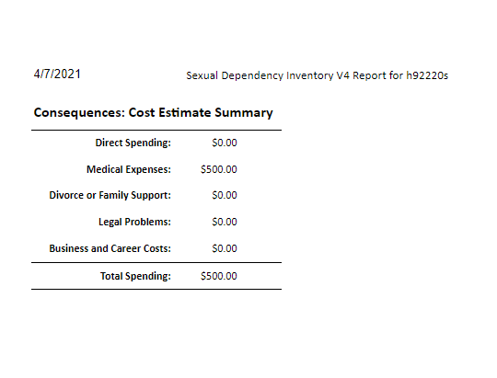
Assessment

Slide 45
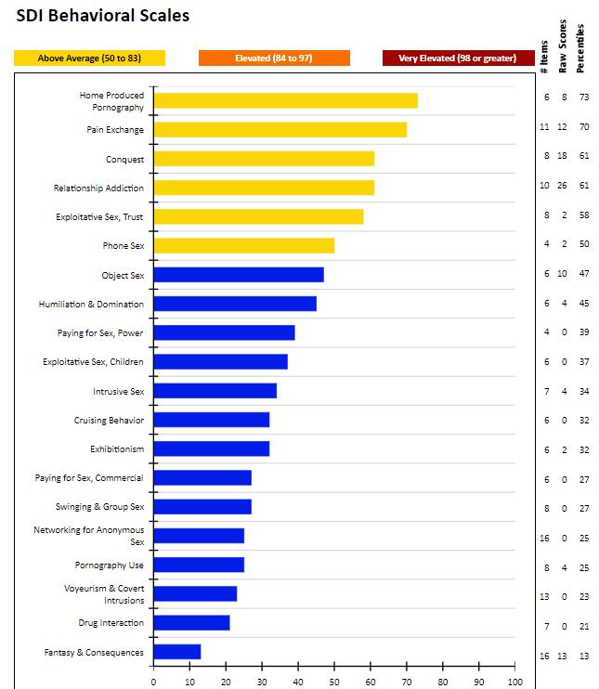
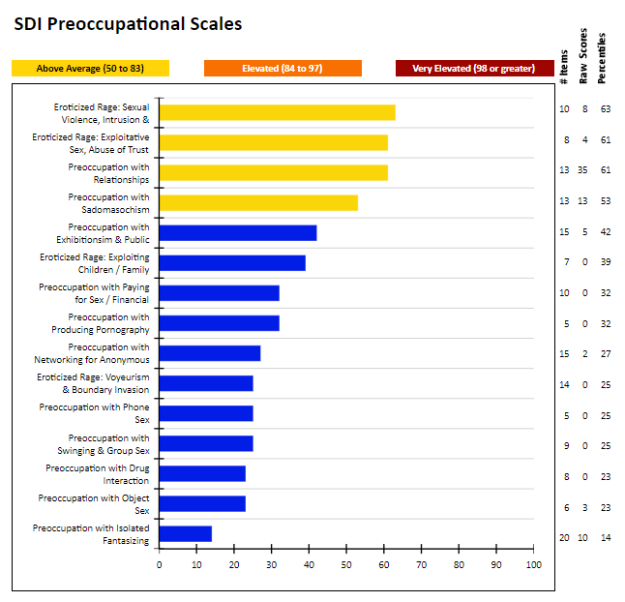
Assessment

Slide 46
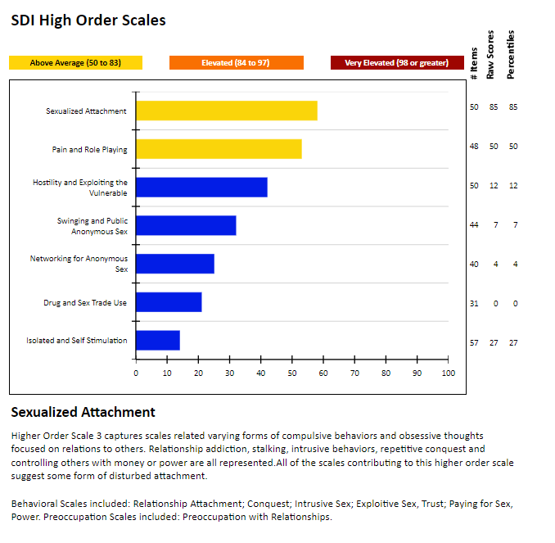
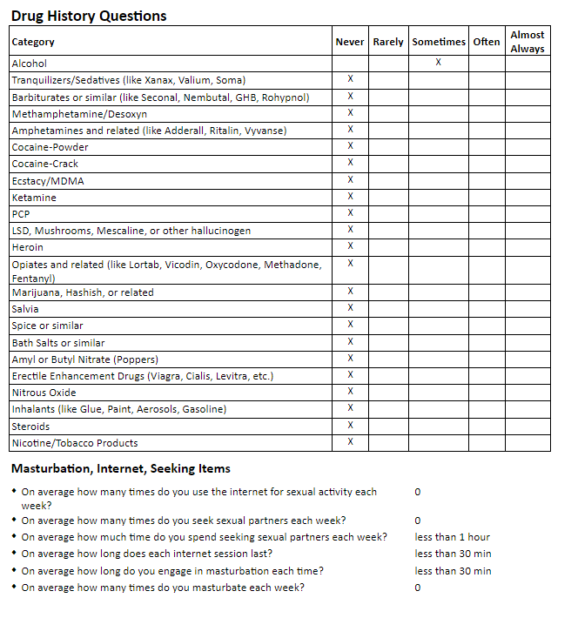
Assessment

Slide 47
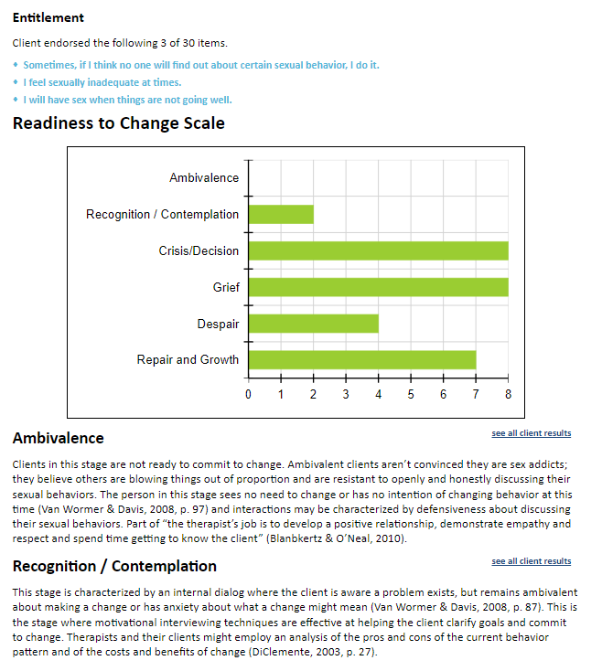
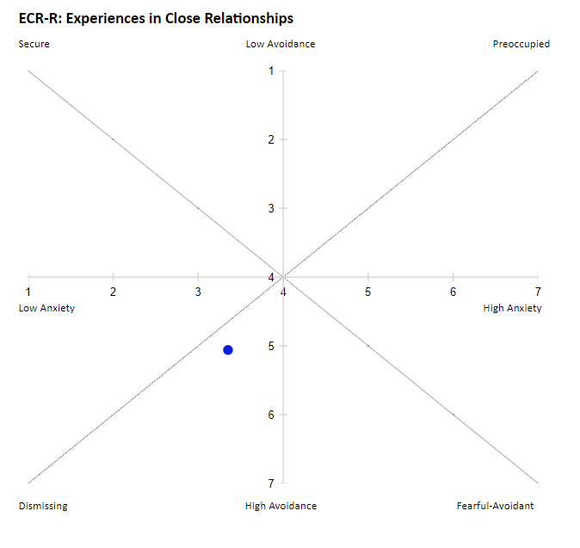
Assessment

Slide 48
Treatment
Individual Therapy
Group Therapy
Support Group Meetings
Sponsor/Mentor/Guide/Coach
12 Steps/Workbooks/Growth
Family Participation
Family Recovery
Couples Recovery
Exercise/Nutrition/Self-Care

Slide 49
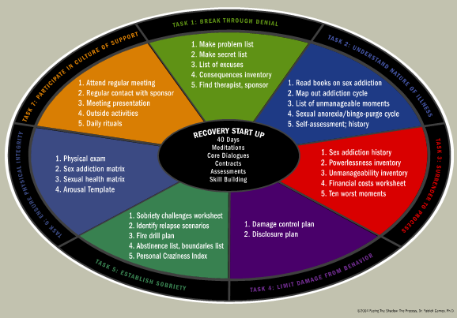
Treatment

Slide 50
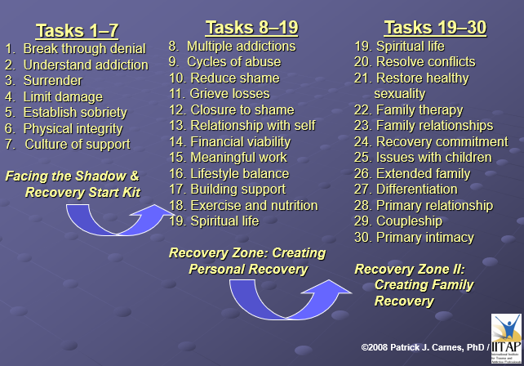

Slide 52
Couples Recovery from Sexual Brokenness
"The Roadmap”
4. Understand Trauma & Messages - Trauma Wall Work
Any negative life event coupled with a sense of helplessness

Slide 53
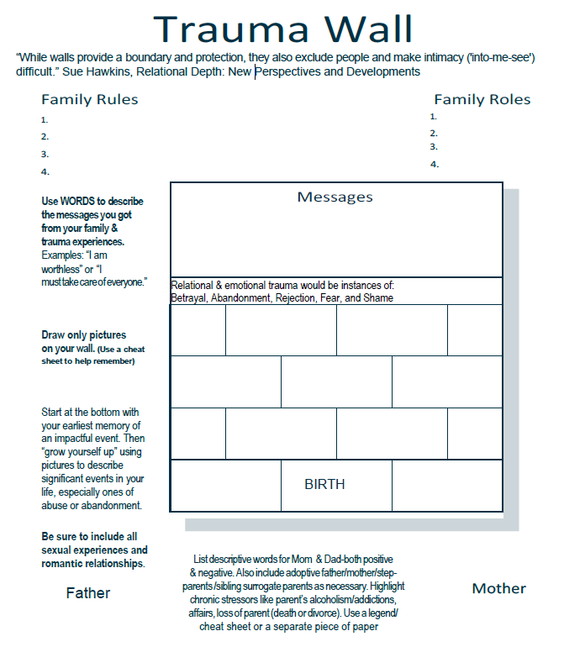

Slide 54
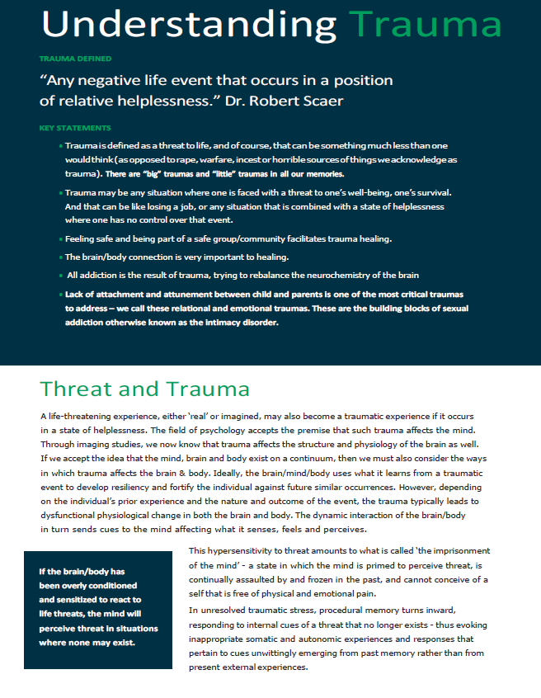
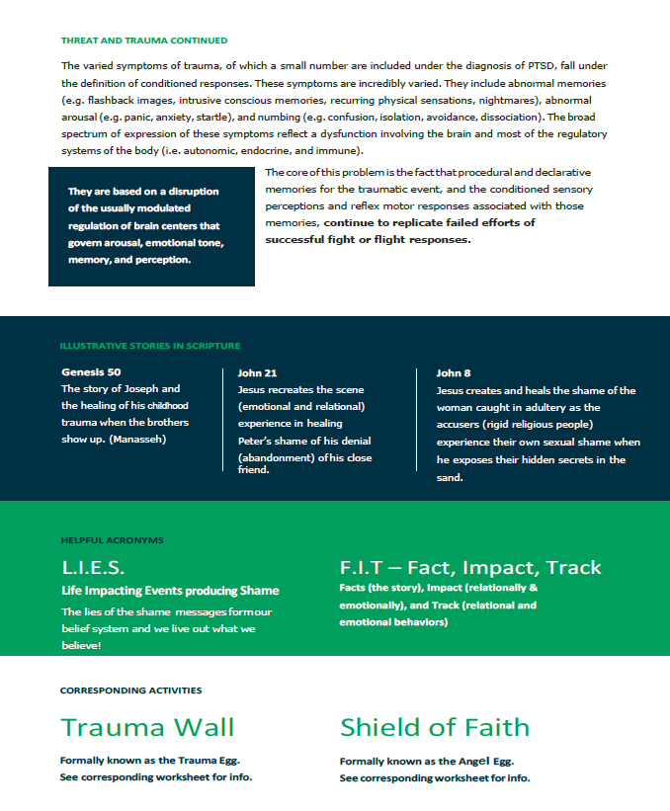

Slide 55
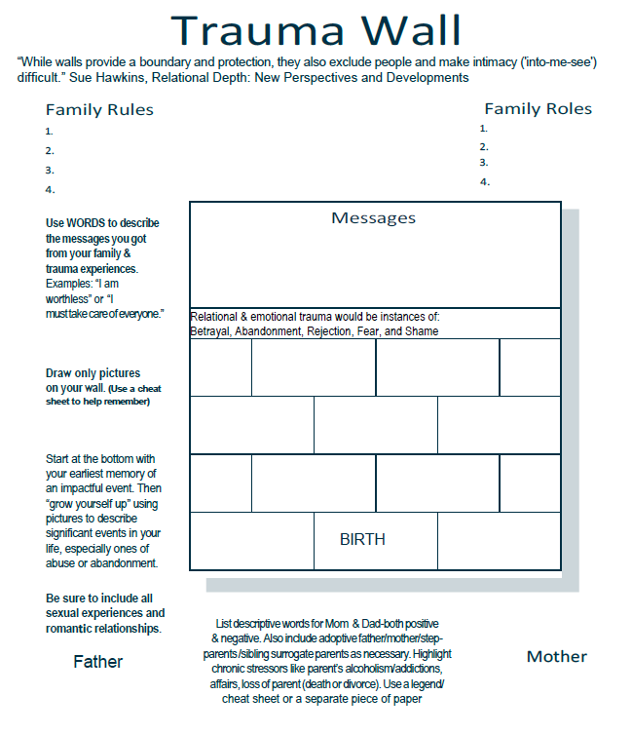
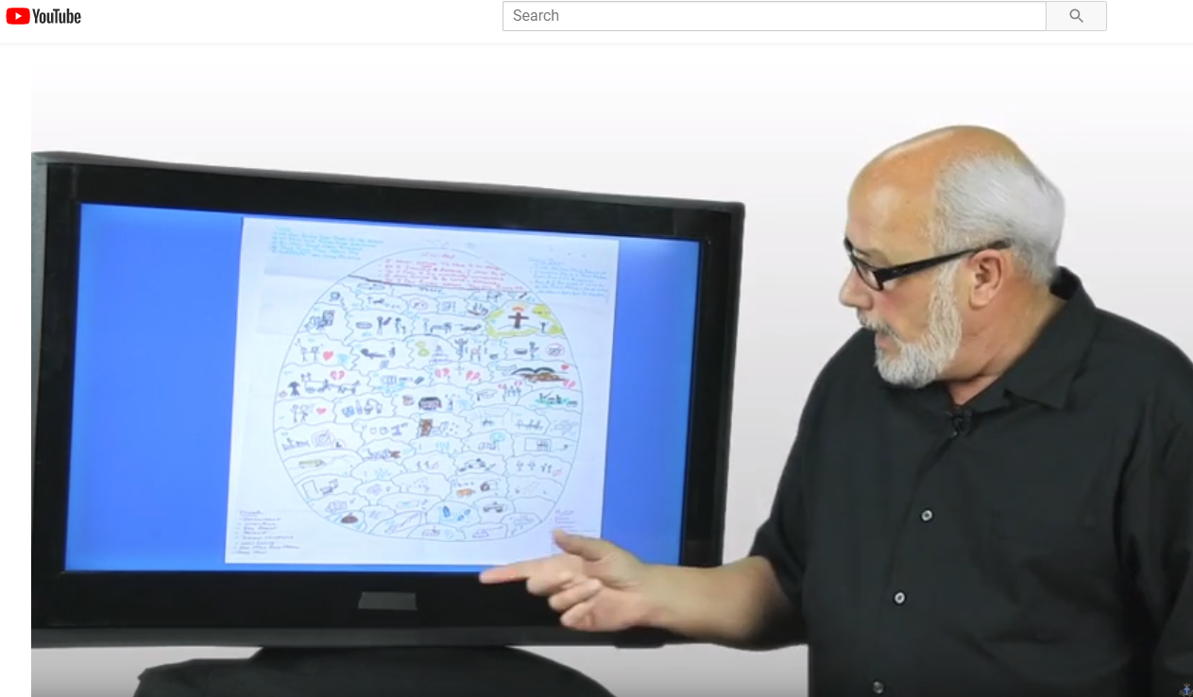
I am not enough I am on my own I am insignificant I am bad I am inadequate
We begin to become aware of the deep false belief system that formed through negative life experiences, the toxic shame messages that reside in the limbic part of our brain that processes memory associated with emotions. The amygdala (fear) and nucleus accumbens (pleasure) are part of this structure.

Slide 56
Purpose of Trauma Work with a Couple
The process brings understanding of the roots of the acting-out behavior and the intimacy disorder in the relationship - they begin to understand the setup. This is the beginning of empathy, with the overall goal of moving from intensity to intimacy. The questions and the trauma wall are designed to create vulnerability, which produces empathy. This is the creation of attachment, the glue that holds relationships together.

Slide 57
Partner Betrayal Trauma
The best description of this phenomenon is partner betrayal trauma—when the person whom someone loves the most is the person who has hurt them more than anyone else.
Other Descriptors include:
Complex PTSD
Sex Addiction-Induced Trauma
Sexual Betrayal Stress Syndrome
Post-Betrayal Stress Disorder
Very real and is rather well-defined in progression and symptoms. It may not be full-blown post-traumatic stress disorder, but it mirrors the symptoms of complex PTSD.

Slide 58
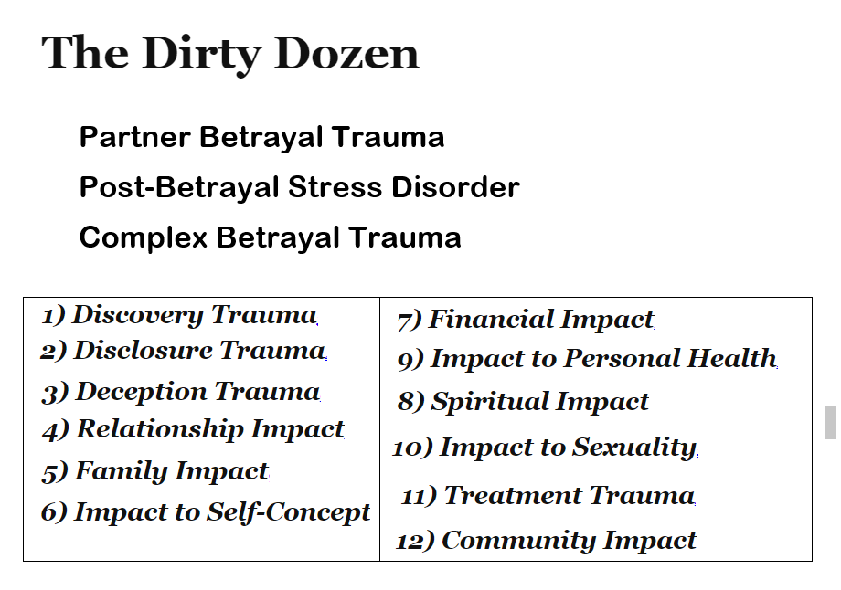

Slide 59
Couples Recovery from Sexual Brokenness
"The Roadmap”
12. Sexual Reintegration Therapy - Couples' Guide to Intimacy (Bercaw)
Trusting God to heal, restore, and redeem your marriage - "recovery" is the Life God intended us to live.

Slide 60
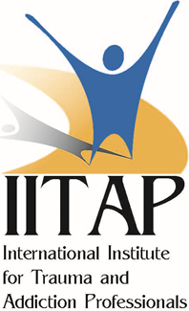
Information
International Institute for Trauma & Addiction Professionals (IITAP)
For more on the Certified Sex Addiction Therapist (CSAT) trainings, the task-centered approach to addiction recovery, and assessment testing for sexual, work and financial issues go to:
www.IITAP.com
Info@IITAP.com

Slide 61
Information
For additional information and links to other resources go to:
LifeWorks.MS
SexGodChaos.com
SexHelp.com

Slide 62
Additional References
American Psychiatric Association, Diagnostic and Statistical Manual of Mental Disorders, Fifth Edition
American Psychiatric Association, Diagnostic and Statistical Manual, Fifth Edition, Revised
Adelson, S., Bell, R., Graff, A., Goldenberg, D., Haase, E., Downey, J. I., & Friedman, R. C. (2012). Toward a definition of “hypersexuality” in children and adolescents. Psychodynamic psychiatry, 40(3), 481-503.
Dickenson, J.A., Gleason, N., Coleman, E., & Miner, M.H. (2018). Prevalence of Distress Associated With Difficulty Controlling Sexual Urges, Feelings, and Behaviors in the United States. JAMA Network Open, 1(7).
Kafka, M. P. (2010). Hypersexual disorder: A proposed diagnosis for DSM-V. Archives of sexual behavior, 39(2), 377-400.
Kraus, S.W., Voon, V., & Potenza, M.N. (2016). Should compulsive sexual behavior be considered an addiction? Addiction 111(12).
Reid, R. C., Carpenter, B. N., Hook, J. N., Garos, S., Manning, J. C., Gilliland, R., ... & Fong, T. (2012). Report of findings in a DSM‐5 field trial for hypersexual disorder. The journal of sexual medicine, 9(11), 2868-2877.
Schultz, K., Hook, J. N., Davis, D. E., Penberthy, J. K., & Reid, R. C. (2014). Nonparaphilic hypersexual behavior and depressive symptoms: a meta-analytic review of the literature. Journal of sex & marital therapy, 40(6), 477-487.

